Slide 1
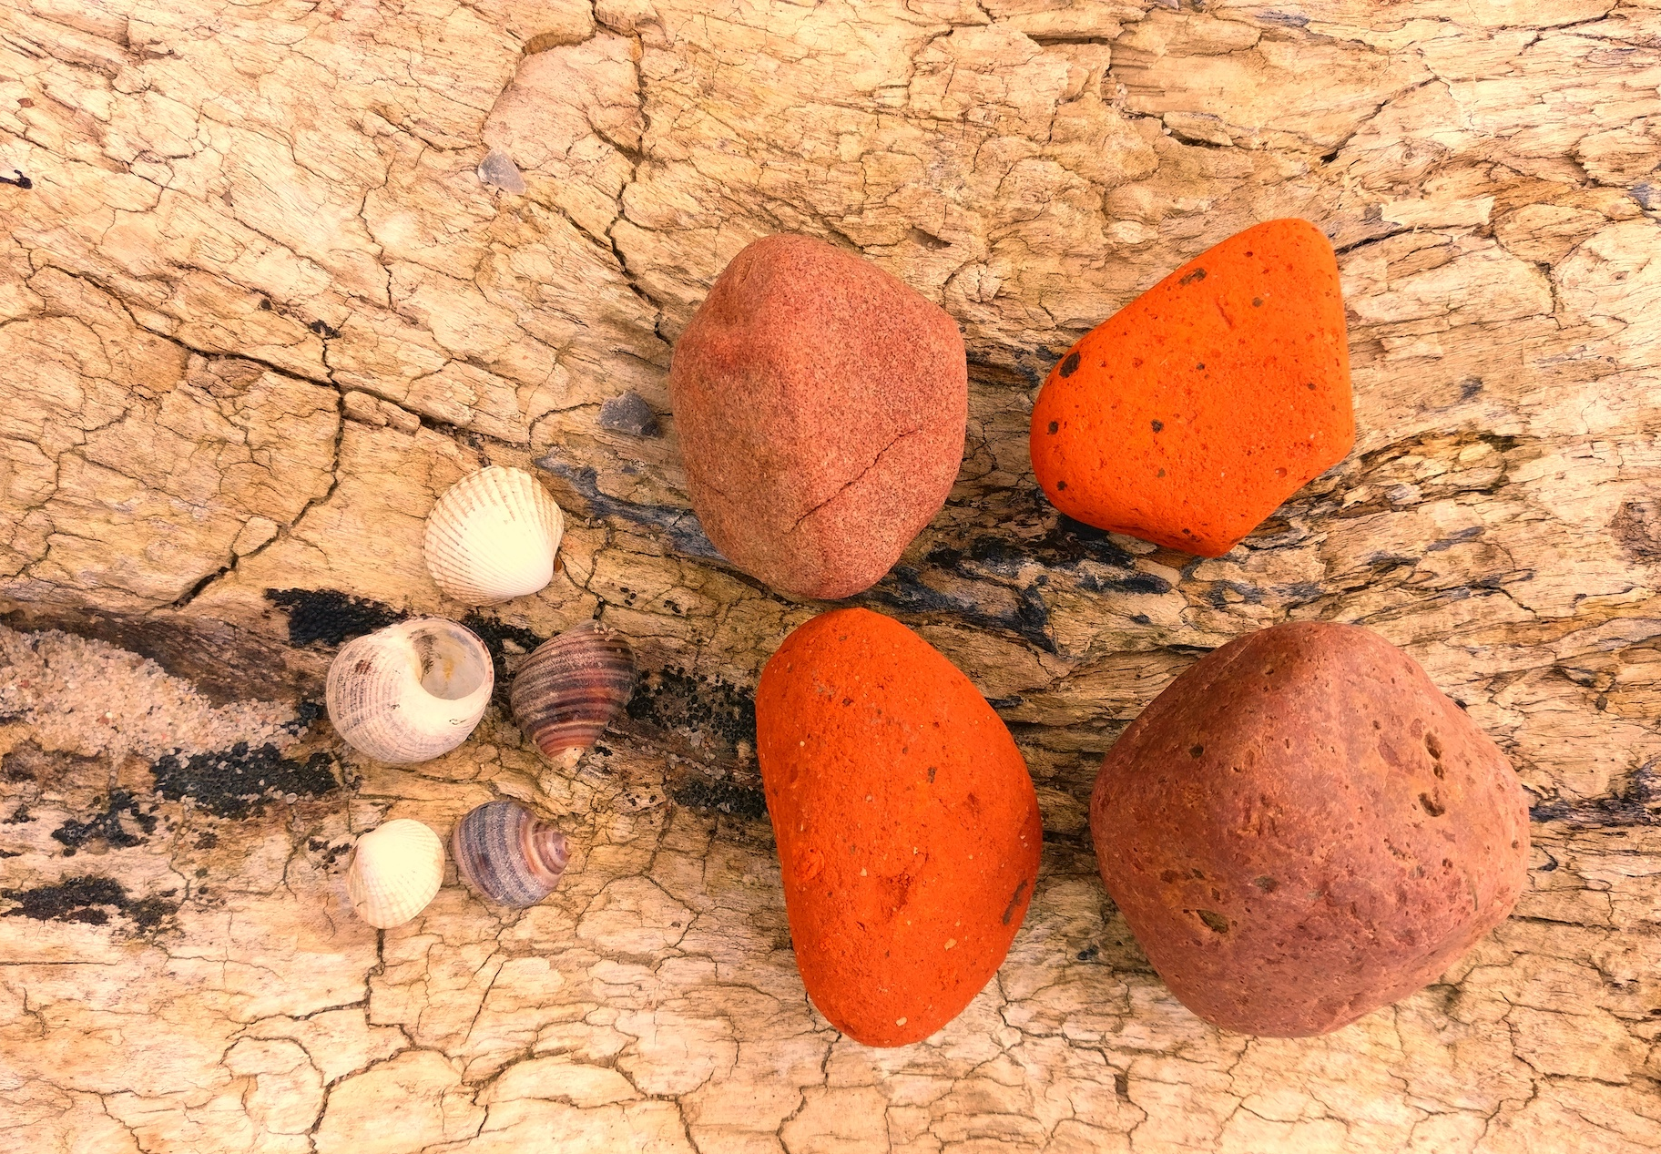
jCon 2021 | October, 6 2021 | @nilshartmann
NILS HARTMANN
https://nilshartmann.net
Building
GraphQL APIs
with Java
Slides (PDF): https://react.schule/jcon-graphql

Slide 2
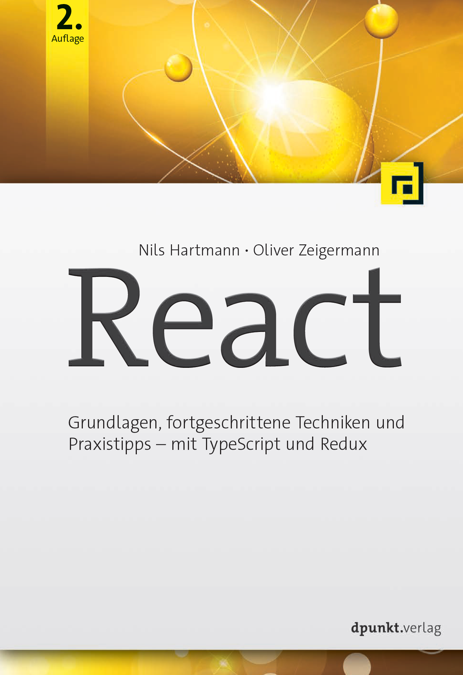
https://nilshartmann.net
NILS HARTMANN
nils@nilshartmann.net
Freelance developer, architect, trainer from Hamburg
Java
JavaScript, TypeScript
React
GraphQL
Trainings, Workshops, Coaching
https://reactbuch.de

Slide 3
Part 1
GraphQL
Basics

Slide 4
"GraphQL is a query language for APIs and a runtime for fulfilling those queries with your existing data"
- https://graphql.org
GraphQL

Slide 5
GraphQL
Specifikation: https://spec.graphql.org/
Published in 2015 by Facebook
Since 2018, the GraphQL specification is developed by the GraphQL Foundation
Spec includes:
Query language
Schema Definition Language
No implementation!
Server reference implementation: graphql-js

Slide 6

Source code: https://github.com/nilshartmann/graphql-java-talk
Example Application

Slide 7

http://localhost:9000
Demo: GraphiQL
https://github.com/graphql/graphiql

Slide 8

GraphQL Queries
Select specific data needed for each use-case
{ beer {
id
name
averageStars
}
}

Slide 9

GraphQL Queries
Select specific data needed for each use-case
{ beer(beerId: "B1" {
name
price
ratings {
stars
comment
author {
name
}
}
shops { name }
}
}

Slide 10

GraphQL Queries
Select specific data needed for each use-case
{ shop(shopId: "S3") {
name
address { street city }
beers { id name }
}
}

Slide 11
"GraphQL is a query language for APIs and a runtime for fulfilling those queries with your existing data"
- https://graphql.org
GraphQL

Slide 12
The GraphQL Query Language

Slide 13
query Language
Structured Language to query/request data from your API
With the language, you select fields from object graphs

Slide 14
query Language
Structured Language to query/request data from your API
With the language, you select fields from object graphs
Fields can have arguments

Slide 15
query Language
Query Result
Identical structure as your query

Slide 16
query Language: Operations
Operation: describe, what the query should do
query, mutation, subscription

Slide 17
query Language: Mutations
Mutations
Mutations can be used to modifiy data
(would be POST, PUT, PATCH, DELETE in REST)

Slide 18
query Language: Mutations
Subscription
Client of your API can subscribe to Server Events, published by the API

Slide 19
Part II
GraphQL
Server

Slide 20
Runtime (AKA: Your application)
"GraphQL is a query language for APIs and a runtime for fulfilling those queries with your existing data"
- https://graphql.org
GraphQL
Server

Slide 21

GraphQL Runtime
GraphQL doesn't say anthing about the source of data
👉 Determining the requested data is our task
👉 Data might not only come from (one) database

Slide 22
GraphQL For Java applications
Two general options
graphl-java: first GraphQL framework for Java
Low level approach, no server etc.
Multiple abstractions on top including support for Spring Boot
graphql-spring-boot
Spring/Spring Boot-based
graphql-java-tools
netflix-dgs
spring-graphql
graphql-java

Slide 23
GraphQL For Java applications
Two general options
graphl-java: first GraphQL framework for Java
Low level approach, no server etc.
Multiple abstractions on top including support for Spring Boot
MicroProfile
graphql-spring-boot
Spring/Spring Boot-based
graphql-java-tools
netflix-dgs
spring-graphql
graphql-java
MicroProfile GraphQL

Slide 24
GraphQL For Java applications
Two general options
graphl-java: first GraphQL framework for Java
Low level approach, no server etc.
Multiple abstractions on top including support for Spring Boot
MicroProfile
We focus first on graphql-java and its related frameworks
graphql-spring-boot
Spring/Spring Boot-based
graphql-java-tools
netflix-dgs
spring-graphql
graphql-java
MicroProfile GraphQL

Slide 25
GraphQL For Java applications
graphql-java
https://www.graphql-java.com/
Pure GraphQL implementation, environment independent (no relations to Spring or JEE)
API is low level

Slide 26
GraphQL Server with graphql-java
Our development tasks
Define the Schema of our API
graphql-java has "schema-first" approach
Implement DataFetchers that collect the requested data
This part varies in the more high level frameworks

Slide 27
GraphQL Schema
We have to describe our API in a Schema
👉 What data we provide is our decision
👉 How our data is provided is our decision
👉 We're still designing our own APIs according to our domain needs and likes

Slide 28
GraphQL Schema
Schema
A GraphQL API have to be defined with a Schema
Schema Definition Language (SDL)

Slide 29
GraphQL Schema
Defining a Schema with SDL
Object Type
type Rating { id: ID!
comment: String! stars: Int
}
Fields

Slide 30
GraphQL Schema
Defining a Schema with SDL
type Rating { id: ID!
comment: String! stars: Int
}
Return Type (non-nullable)
Return Type (nullable)

Slide 31
GraphQL Schema
Defining a Schema with SDL
type Rating { id: ID!
comment: String! stars: Int
author: User! }
type User {
id: ID!
name: String!
}
References

Slide 32
GraphQL Schema
Defining a Schema with SDL
type Rating { id: ID!
comment: String! stars: Int
author: User! }
type User {
id: ID!
name: String!
}
type Beer {
name: String!
ratings: [Rating!]!
}
List / Array

Slide 33
GraphQL Schema
Defining a Schema with SDL
type Rating { id: ID!
comment: String! stars: Int
author: User! }
type User {
id: ID!
name: String!
}
type Beer {
name: String!
ratings: [Rating!]!
ratingsWithStars(stars: Int!): [Rating!]!
}
Arguments

Slide 34
GraphQL Schema
Root-Types: Entry-Points into the API (Query, Mutation, Subscription)
Root-Type
("Query)
type Query { beers: [Beer!]!
beer(beerId: ID!): Beer }
type Mutation { addRating(newRating: NewRating): Rating! }
type Subscription {
onNewRating: Rating!
}
Root-Fields
Root-Type
("Mutation")
Root-Type
("Subscription")

Slide 35
Resolving your query: Data Fetchers

Slide 36
Data Fetchers
DataFetcher
A DataFetcher determines and returns the value for a Field
Required for all fields of your Root-Types (Query, Mutation)
For all other fields, Reflection is used (getter/setter, Maps, ...) by default

Slide 37
Data Fetchers
DataFetcher
A DataFetcher determines and returns the value for a Field
Required for all fields of your Root-Types (Query, Mutation)
For all other fields, Reflection is used (getter/setter, Maps, ...) by default
A DataFetcher is a functional Java interface

Slide 38
Data Fetchers
DataFetcher
A DataFetcher determines and returns the value for a Field
Required for all fields of your Root-Types (Query, Mutation)
For all other fields, Reflection is used (getter/setter, Maps, ...) by default
A DataFetcher is a functional Java interface
interface DataFetcher<T> { T get(DataFetchingEnvironment environment); }

Slide 39
DataFetcher
Implementing DataFetchers
Example: A simple field
Schema Definition
type Query { beer(id: ID!): Beer
}

Slide 40
DataFetcher
Implementing DataFetchers
Example: A simple field
Schema Definition
type Query { beer(id: ID!): Beer
}
"data": {
"beer":
{ "name": "...", "price": 5.3 }
}
Query
query { beer(id: "B1")
{ name price }
}

Slide 41
DataFetcher
Implementing DataFetchers
Example: A simple field
Schema Definition
type Query { beer(id: ID!): Beer
}
"data": {
"beer":
{ "name": "...", "price": 5.3 }
}
Query
query { beer(id: "B1")
{ name price }
}
Data Fetcher
public class QueryDataFetchers {
DataFetcher<Beer> beer = new DataFetcher<>() {
public Beer get(DataFetchingEnvironment env) {
String id = env.getArgument("id");
return beerRepository.getBeerById(id);
}
};
}

Slide 42
DataFetcher
Implementing DataFetchers
Example: A simple field
Schema Definition
type Query { beer(id: ID!): Beer
}
"data": {
"beer":
{ "name": "...", "price": 5.3 }
}
Query
query { beer(id: "B1")
{ name price }
}
Data Fetcher
public class QueryDataFetchers {
DataFetcher<Beer> beer = new DataFetcher<>() {
public Beer get(DataFetchingEnvironment env) {
String id = env.getArgument("id");
return beerRepository.getBeerById(id);
}
};
}
Assume Beer Pojo
contains "name" and "price" property

Slide 43
DataFetcher
DataFetcher: Mutations
technically the same as queries, but you're allowed to modify data here
Schema Definition
input AddRatingInput { beerId: ID!
stars: Int!
}
type Mutation { addRating(input: AddRatingInput!): Rating!
}
Data Fetcher
public class MutationDataFetchers {
DataFetcher<Rating> addRating = new DataFetcher<>() {
public Rating get(DataFetchingEnvironment env) {
Map input = env.getArgument("input");
String beerId = input.get("beerId");
Integer starts = input.get("stars");
return ratingService.newRating(beerId, stars);
}
};
}

Slide 44
DataFetcher
DataFetcher: Subscriptions
Same as DataFetchers for Query, but must return Reactive Streams Publisher
Typically used in Web-Clients with WebSockets
import org.reactivestreams.Publisher;
public class SubscriptionDataFetchers {
DataFetcher<Publisher<Rating>> onNewRating = new DataFetcher<>() {
public Publisher<Rating> get(DataFetchingEnvironment env) {
Publisher<Rating> publisher = getRatingPublisher();
return publisher;
}
};
}
type Subscription {
onNewRating: Rating!
}

Slide 45
Object GraphS
DataFetcher for own Types (not Root Types)
By default graphql-java uses a "PropertyDataFetcher" for all fields that are not on Root Types
PropertyDataFetcher uses Reflection to return the requested data from your Pojo
(Fields not defined in your schema, but part of your Pojo are never returned to the client!)
Your returned Pojo and GraphQL schema might not match
Different/missing fields

Slide 46
Object GraphS
DataFetcher for own Types (not Root Types)
Example: There is no field "shops" on our Beer class
public class Beer {
String id;
String name;
...
}
query {
beer(id: 1) {
name
shops {
name
}
}
}
no 'shops' here 🤔

Slide 47
Object GraphS
DataFetcher for own Types (not Root Types)
You can write DataFetcher for all fields in your GraphQL API
Non-Root Fetcher works the same, as DataFetchers for Root-Fields
They receive their parent object as "Source"-Property from the DataFetchingEnvironment
query {
beer(id: 1) {
name
shops {
name
}
}
}
public class BeerDataFetchers {
DataFetcher<List<Shop>> shops = new DataFetcher<>() {
public String get(DataFetchingEnvironment env) {
Beer parent = env.getSource();
String beerId = parent.getId();
return shopRepository.findShopsSellingBeer(beerId);
}
};
}

Slide 48
Higher level Frameworks

Slide 49
Higher level Frameworks
All share similiar ideas
Do not use DataFetcher directly, but abstraction
graphql-java-tools not Spring/JEE related, but there are adapters
Netflix DGS and spring-graphql look very similiar
Both target Spring Boot
graphql-spring-boot
graphql-java-servlet
2017
2/2021
7/2021
First (open-source) Release
graphql-java-tools
netflix-dgs
spring-graphql
2015
graphql-java

Slide 50
GraphQL For Java applications
graphql-java-tools
https://github.com/graphql-java-kickstart/graphql-java-tools
Implement your API using POJOs
graphql-java-tools
graphql-java

Slide 51
graphql-java-tools
Resolver with graphql-java-tools
Example: Resolver for Root-Field
public class BeerQueryResolver implements GraphQLQueryResolver {
public Beer beer(String beerId) {
return beerRepository.getBeerById(beerId);
}
}

Slide 52
graphql-java-tools
Resolver with graphql-java-tools
Example: Mutation and Input Types
Complex arguments (GraphQL input types) are deserialized to POJO instances and passed to your resolver method
public class AddRatingInput {
private String beerId;
private int stars;
...
}
public class BeerAdvisorMutationResolver implements GraphQLMutationResolver { public Rating addRating(AddRatingInput input) {
return ratingService.createRating(input);
}
}

Slide 53
graphql-java-tools
Resolver with graphql-java-tools
Examples: Resolvers for fields not on root types
The parent object (getSource in graphql-java) will be passed as first method parameter
public class BeerResolver implements GraphQLResolver<Beer> { public List<Shop> getShops(Beer parent) {
return shopRepository.findShopsSellingBeer(parent.getId());
}
}

Slide 54
GraphQL For Java applications
spring-graphql
https://docs.spring.io/spring-graphql/docs/current-SNAPSHOT/reference/html/
"Official" Spring solution for GraphQL
Takes graphql-java and combines it with Spring Boot (concepts)
Exposes Endpoint using Spring WebMVC, Spring WebFlux
Supports subscriptions using WebSockets
Still in beta status, released only some weeks ago in July
spring-graphql
graphql-java

Slide 55
GraphQL For Java applications
Annotated Controllers
Annotation-based programming model, similiar to REST controllers
@Controller
public class BeerQueryController {
BeerQueryController(BeerRepository beerRepository) { ... }
@QueryMapping
public List<Beer> beers() {
return beerRepository.findAll();
}
@MutationMapping
public Rating addRating(@Argument AddRatingInput input) {
return ratingService.createRating(input);
}
}
Mapping to Schema via Naming convention

Slide 56
GraphQL For Java applications
Annotated Controllers
Annotation-based programming model, similiar to REST controllers
@Controller
public class BeerQueryController {
BeerQueryController(BeerRepository beerRepository) { ... }
@QueryMapping
public List<Beer> beers() {
return beerRepository.findAll();
}
@MutationMapping
public Rating addRating(@Argument AddRatingInput input) {
return ratingService.createRating(input);
}
}
Arguments via Method Parameters

Slide 57
GraphQL For Java applications
Annotated Controllers
Annotation-based programming model, similiar to REST controllers
@Controller
public class BeerQueryController {
BeerQueryController(BeerRepository beerRepository) { ... }
@QueryMapping
public List<Beer> beers() {
return beerRepository.findAll();
}
@MutationMapping
public Rating addRating(@Argument AddRatingInput input) {
return ratingService.createRating(input);
}
@SchemaMapping
public List<Shop> shops(Beer beer) {
return shopRepository.findShopsSellingBeer(beer.getId());
}
}
Parent-Objects as Method Parameters

Slide 58
GraphQL For Java applications
Nextflix Domain Graph Service Framework (DGS)
https://netflix.github.io/dgs/
Published first in February 2021
Based on Spring Boot and graphql-java

Slide 59
GraphQL For Java applications
Nextflix Domain Graph Service Framework (DGS)
https://netflix.github.io/dgs/
Published first in February 2021
Based on Spring Boot and graphql-java
Features not available in spring-graphql:
Code-Generator for Gradle and Maven creates from your schema definition Java classes
Supports Subscriptions
Support for Apollo Federation (combining multiple APIs into one)

Slide 60
GraphQL For Java applications
Nextflix Domain Graph Service Framework (DGS)
https://netflix.github.io/dgs/
Published first in February 2021
Based on Spring Boot and graphql-java
Features not available in spring-graphql:
Code-Generator for Gradle and Maven creates from your schema definition Java classes
Supports Subscriptions
Support for Apollo Federation (combining multiple APIs into one)
Difficult to say, how DGS and spring-graphql will differ, what will be the "better" framework

Slide 61
GraphQL For Java applications
MicroProfile GraphQL
Annotation based programming model
Code-first: Schema is derived from your Code (Entities and Components)
(as opposite to Schema-frist in graphql-java)
MicroProfile GraphQL

Slide 62
MicroProfile GraphQL
Example: Use Pojos to define your Types
@Type
@Name("beer")
@Description("Represents a Beer that can be rated")
public class Beer {
@Ignore
private String primaryKey; // not part of the GraphQL API
@NonNull
private String name;
private int price;
...
}

Slide 63
MicroProfile GraphQL
Example: Use Components to define your Queries and Mutations
@GraphQLApi
public class BeerApi {
@Inject
BeerRepository beerRepository;
ShopRepository shopRepository;
@Query
@Description("Returns a specific beer, identified by its id")
public Beer beer(@Name("id") String id) {
return beerRepository.getBeerById(id);
}
public List<Shop> shops(@Source beer) {
return shopRepository.findShopsSellingBeer(beer.getId());
}
}

Slide 64
GraphQL For Java applications
Conclusion: what framework should I pick?
Spring World: spring-graphql or Netflix DGS
Future will tell what is better (might be that Netflix DGS will be based on spring-graphql but adding more features)

Slide 65
GraphQL For Java applications
Conclusion: what framework should I pick?
Spring World: spring-graphql or Netflix DGS
Future will tell what is better (might be that Netflix DGS will be based on spring-graphql but adding more features)
JEE
graphql-java or graphql-java-tools and graphql-java-servlet

Slide 66
GraphQL For Java applications
Conclusion: what framework should I pick?
Spring World: spring-graphql or Netflix DGS
Future will tell what is better (might be that Netflix DGS will be based on spring-graphql but adding more features)
JEE
graphql-java or graphql-java-tools and graphql-java-servlet
MicroProfile
Microprofile GraphQL

Slide 67
HTTPS://NILSHARTMANN.NET | @nilshartmann
🌻
Thank you!
Slides: https://react.schule/jcon-graphql
Contact: nils@nilshartmann.net

